Slide 1
Introduction to Bioinformatics
Dr Sam Robson
Bioinformatics Group

Slide 2
Contents
Introduction
Next Generation Sequencing
NGS Data Formats
ChIP-Seq
RNA-Seq
Whole Genome Sequencing
Bioinformatics Resources
Essential Bioinformatics Skills

Slide 3
Contents
Introduction
Next Generation Sequencing
NGS Data Formats
ChIP-Seq
RNA-Seq
Whole Genome Sequencing
Bioinformatics Resources
Essential Bioinformatics Skills

Slide 4
What The Hell Is Bioinformatics?
Notes:
- As technology improves, our ability to collect data in biological experiments is ever increasing
- However, the skills to understand and make sense of these data are often difficult to come by
- Bioinformatics lies somewhere between computer science, statistics and biology
- Broadly speaking, the idea is to use programmatic means to solve biological problems
- A lot of that can be finding ways to deal with large sets of data, and reducing them down in a simple to understand way
- In addition, it involves using statistical techniques to ask specific questions of the data
- For instance, the advent of next generation sequencing has allowed us to sequence entire genomes and transcriptomes
- However, we then want to reduce this down in order to answer specific questions:
- Which genes are differentially expressed when you treat with a specific drug?
- Which mutations are associated with a particular disease?
- How does the genome of my new species of bacteria differ from those already known?
- More and more biological projects will need bioinformatics assistance in the future

Slide 5
Data Increase Over Time
Muir, P., Li, S., Lou, S., Wang, D., Spakowicz, D. J., Salichos, L., et al. (2016). The real cost of sequencing: scaling computation to keep pace with data generation. Genome Biology, 17(1), 53. http://doi.org/10.1186/s13059-016-0917-0
Notes:
- The amount of data deposited in online repositories such as the Sequence Read Archive has increased exponentially (beyond Moore’s Law)
- Storage resources such as SRA are incredibly important not only to allow efficient storage of data, but also to allow access by the wider community
- With the advent of next generation sequencing platforms, sequencing costs have fallen
- Funding for sequencing projects has also increased dramatically
- Several large scale projects generating huge amounts of sequencing data – e.g. the cancer genome atlas, 1000 Genomes project and Encylopedia of DNA Elements
- These projects aim to provide large scale maps of various aspects of human genomics

Slide 6
Data Increase Over Time
Notes:
- The rate of data acquisition is increasing, but the skills to deal with these data and the infrastructure to store and analyse it is not keeping pace
- Over time, it is likely that more and more areas of biological sciences will move into the realms of “big data”
- Not just sequencing, but high throughput methods are being developed for many other branches of biology
- Inter-disciplinary science is becoming more and more important
- Communication between scientists from different backgrounds is very important

Slide 7
Contents
Introduction
Next Generation Sequencing
NGS Data Formats
ChIP-Seq
RNA-Seq
Whole Genome Sequencing
Bioinformatics Resources
Essential Bioinformatics Skills

Slide 8
Sanger Sequencing
https://en.wikipedia.org/wiki/Sanger_sequencing#/media/File:Sanger-sequencing.svg
Notes:
- Developed by Frederick Sanger in 1977
- Single strand DNA template used
- Second strand synthesis through DNA polymerase
- 4 reactions – each one using 4 dNTPs and a small amount of a single flourescently labelled di-deoxynucleotide triphosphate
- As the second strand is built from the dNTPs, ddNTPs are randomly incorporated and terminate the chain extension
- Mixture of strands of different lengths separated through capillary gel electropheresis
- Detection of the flourochrome terminating the fragments in each of the four reactions allows you to build up the sequence

Slide 9
Next Generation Sequencing
High throughput way of ”reading” many DNA/RNA sequences at the same time
Many different NGS technologies (each with pros & cons):
Illumina (low cost, high throughput, but short reads)
Ion Torrent (low error rate and fast, but relatively short reads)
Roche 454 (longer reads, fast, but expensive and now defunct)
“Next” next generation sequencing:
Pacific Biosciences (very long reads, directly sequence individual molecules, identify base modifications, but currently high error rates)
Oxford Nanopore (very long reads, directly sequence individual molecules, identify base modifications, but currently high error rates)
Notes:
Sanger sequencing is limited in the number of distinct sequences that can be measured
Next generation sequencing allows high throughput sequencing of many more nucleotides in parallel
Lots of different methods, each with pros and cons depending on what you are sequencing
Illumina is the most common due to the high throughput and low cost, but less suitable for de novo assembly due to small reads
Ion Torrent has a lower error rate due to not using optics (pyrosequencing based on release of H+ rather than fluorophore)
Roche 454 uses pyrosequencing (but based on release of fluorescent molecule) and generates longer reads, but is more expensive (and is now no longer supported)
New technologies produce much longer reads (Kb up to Mb length) but suffer issues with high error rates
Oxford Nanopore passes the molecule through a biological nanopore and detects changes in potential across the channel as the molecule passes through (direct sequencing of the DNA/RNA rather than cDNA surrogates)
Pacific Bioscience uses Single Molecule Real Time (SMRT) sequencing in a zero mode waveguide channel, so sequences single molecules but through a sequencing by synthesis process. Circularised nucleotide strand, so multiple passes can reduce the error rates.

Slide 10
Illumina Sequencing
 | MiSeq | NextSeq 500/550 |  | HiSeq 2500 |  | HiSeq 4000 | HiSeq X
Key Applications | Small genomes, targeted gene sequencing, metagenomics | Exome sequencing, amplicon gene sequencing, whole-transcriptome sequencing, gene expression profiling, methylation sequencing, small to medium whole genome sequencing |  | Exome sequencing, amplicon gene sequencing, whole-transcriptome sequencing, gene expression profiling, methylation sequencing, medium to large whole genome sequencing |  | Exome sequencing, amplicon gene sequencing, whole-transcriptome sequencing, gene expression profiling, methylation sequencing, medium to large whole genome sequencing | Exome sequencing, amplicon gene sequencing, whole-transcriptome sequencing, gene expression profiling, methylation sequencing, large whole genome sequencing
Run mode | NA | Mid-Output | High-Output | Rapid Run | High-Output | NA | NA
Run Time | 5-65 hrs | 5-26 hrs | 12-30 hrs | 29 hrs - 6 days | 7-60 hrs | <1-3.5 days | <3 days
Max Output | 0.3-15 Gb | 20-39 Gb | 30-120 Gb | 10-180 Gb Gb | 50-1000 Gb | 1500 Gb | 1.6-1.8 Tb
Max Reads per Run | 25 million | 130 million | 400 million | 300 million | 2 billion | 5 billion | 3 billion
Max Read Length | 2 x 300bp | 2 x 150bp | 2 x 150bp | 2 x 150bp | 2 x 125bp | 2 x 150bp | 2 x 150bp
Cost | $ | $$ | $$ | $$$ | $$$ | $$$$ | $$$$$
Notes:
Illumina sequencing accounts for the vast majority of all sequencing data currently available
Relatively cheap allowing high coverage for low costs
Small read lengths (up to 300 bp) are a negative
Difficult to sequence genomes with small reads as they cannot span repetitive regions – often combined with longer read sequences like PacBio to fill in the gaps
Many different machines depending on what you need
MiSeq and NextSeq are desk based machines, whilst HiSeq are production-level machines typically found at larger sequencing facilities

Slide 11
Illumina Sequencing
https://bitesizebio.com/13546/sequencing-by-synthesis-explaining-the-illumina-sequencing-technology/
Notes:
Illumina uses Sequencing by Synthesis approach similar to Sanger
DNA is sheared to give short fragments (size selection can be used to select within certain size range)
cDNA libraries with adapters for binding to the flowcell are generated
Libraries are washed across the flow cell where they will randomly anneal
“Bridge amplification” stage uses solid phase PCR to amplify clusters of identical free sequence
The sequences are then built up over a set number of cycles (determined by the chosen read length)
For each cycle, dNTPs with reversible terminators containing a fluorophore are added sequentially (e.g. A, then C, then G, then T)
After each addition, a snapshot of the flow cell is taken
Then the terminators are removed so that in the next reaction a new dNTP can anneal
At the end, the computer defines the boundaries of the clusters and builds the sequence for that cluster based on the stack of images

Slide 12
Paired End Reads
Sequence both ends of the DNA fragments - forward and reverse orientation
Each read pair gives the sequence at either end of the fragments
Paired reads are complementary to one another
Must be kept in sync
Insert size and sequence of the fragment can be inferred after mapping
Improves mappability, allows identification of indels, effectively doubles the coverage
https://www.illumina.com/technology/paired_end_sequencing_assay.html
Notes:
Reads can be paired end or single end
Paired end reads have different primers on the two strands (forward and reverse) of the library
These are both sequenced giving a pair of reads for each fragment
The forward reads are sequenced first followed by the reverse pair, so typically the base calling quality is worse for the second read in the pair
Whilst single end reads can only tell us about a fraction of the fragment (e.g. the first 100 bp for SE100 reads), we can infer the sequence of the entire fragment from the sequence between the two pairs after mapping
Paired end reads are also easier to map since if one read in the pair maps ambiguously to multiple locations in the genome, the other may map uniquely, allowing the ambiguity to be resolved
Also doubles the coverage for not much more cost
Allows calling of variants such as indels not possible with single end

Slide 13
Barcoding
https://emea.illumina.com/content/dam/illumina-marketing/documents/products/illumina_sequencing_introduction.pdf
Notes:
Rather than sequence each sample independently, it is possible to run multiple samples on a single flow cell lane
Up to 96 using standardised kits, and more using home-made barcodes
Each library is created incorporating a unique barcode specific to that sample
All samples are pooled into a single sequencing run
Data output contains the characteristic barcodes in addition to the read sequence
Demultiplexing allows the sequences to be correctly partitioned between the samples
This can save on costs by requiring fewer sequencing runs for each experiment
Also allows multiplexing of all samples in a given experiment and running the pool over multiple lanes to avoid confounding lane effects with biological effects

Slide 14
Applications for NGS
Genomics
Whole genome de novo assembly
Genotyping and variant calling
Whole exome sequencing
Metagenomics
Gene regulation
Transcription factor binding
Chromatin modifications
ncRNA binding
DNA methylation
Transcriptomics
Whole transcriptome assembly
Gene expression analysis
Splicing
Notes:
Whole genome de novo assembly to assemble an entire genome from scratch. Illumina reads generally too short for this, and need longer reads in addition to bridge the gaps
Genotyping and variant calling to identify SNPs, CNVs, and structural variants (e.g. for genome wide association studies)
Whole exome sequencing. Like whole genome sequencing, but enriched for exonic sequences. This increases coverage for the coding regions of the genome, but misses potentially interesting things in the non-coding portion (not all causal variants are exonic)
Metagenomics is used to assess the presence of various species amongst environmental samples (e.g. bacteria in soil). 16s rRNA amplicon sequencing and whole transcriptome assembly are often used.
ChIP seq (chromatin immunoprecipitation) to find epigenetic changes on chromatin or to identify transcription factor binding sites
DNA methylation sequencing allows you to identify methylated cytosines through bisulfite treatment. Converts non-methylated cytosines to uracil, so any cytosines in the sequence must be methylated
Whole transcriptome assembly to generate (spliced) transcriptome from RNA. Can be compared to known functional gene sequences to identify functional sequence domains and find homologs.
Gene expression analysis using RNA seq to quantify gene expression and compare between different conditions. Analysis of reads that span exon-intron junctions allows you to identify different splice isoforms.

Slide 15
Experimental Design
Replicates (how many you need should be determined before you start based on what you want to test – power calculation)
Batch effects (control for batch effects through blocking and randomisation)
Paired end or single end
DNA/RNA extraction procedure
Library preparation kit
Protocol optimisation
Number of cycles (read length)
Stranded?
Coverage (be aware of non-uniform coverage – e.g. heterochromatin)
Multiplexing
Controls
Low complexity and contamination
Notes:
Important to have enough replicates to ensure statistical robustness in your analysis. This should be determined ahead of time with a power calculation to determine what magnitude of changes you have power to detect with confidence.
Batch effects can creep in at any stage. For example, if you run all of your samples on one day and half on the next day, and you use different reagents one day, there will be subtle differences between the two groups as a result of variation in the reagents. If you process all from group1 on one day and all from group 2 the next day, you cannot say whether any differences you see are due to the biological difference between the groups, or simply a difference in the reagents. Aim to make batch effects orthogonal to biological effects.
When choosing paired end or single end, it is important to think about what you want to accomplish. SE is cheaper but not by much, and PE produces fewer ambiguous mappings. Paired end gives you better estimates of the fragment sizes and also more sequences.
The choice of which kit to use to extract the RNA/DNA will largely depend on the amount of molecules you expect to get. If using a smaller number of cells you will need to use a kit designed specifically for low input samples.
The library prep kit will depend on some of your other decisions (e.g. PE or SE, stranded, approach to accounting for rRNA, etc.)
The number of cycles determines the read length, the time it takes to run, and the quality of the reads (since quality drops towards the 3’ of the reads)
Choosing a stranded RNA protocol will use only the first strand or second strand of the cDNA libraries, ensuring that you know precisely which strand the sequence arose from. This is important if you are looking at RNA which can come from either strand. In some cases we see overlapping transcripts, and without a stranded protocol it is important to discern one of these transcripts from the other.
Coverage is important as you need to see enough reads in each location of the genome to be able to get robust results. There is no hard threshold, and depends on what you are sequencing. Bear in mind coverage is not uniform as some regions are easier to sequence than others.
Multiplexing allows you to sequence more than one sample on a single lane. A good way to avoid batch effects is to multiplex all samples in a single pool then run over multiple lanes to get the required coverage. However, balancing must be done carefully to ensure uniform coverage across all samples.
Which controls best suit your needs? Negative ChIP control using an antibody that does not pull down much (e.g. IgG)? The DNA Input? RNA from a WT vs some mutant line? Antibody for the histone on which the modification of interest is found?
Be aware of contamination in your data – e.g. in total RNA, up to 90% of the RNA may be ribosomal. Also may see PCR duplicates caused by amplification of low complexity samples. Also watch out adapter dimer contamination.

Slide 16
Contents
Introduction
Next Generation Sequencing
NGS Data Formats
ChIP-Seq
RNA-Seq
Whole Genome Sequencing
Bioinformatics Resources
Essential Bioinformatics Skills

Slide 17
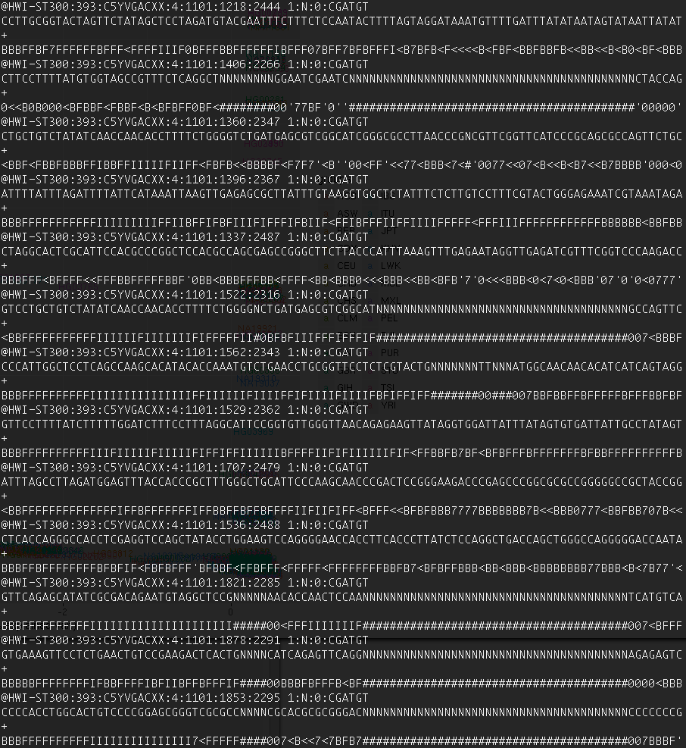
Raw Sequencing Data (.fastq)
Similar to sequence .fasta format but with quality scores
Plain text file
4 lines per read:
Header: @HWI-ST300:393:C5YVGACXX:4:1101:1218:2444 1:N:0:CGATGT
Sequence: CCTTGCGGTACTAGTTCTATAGCTCCTAGATGTACGAATTTCTTTCTCCAATACTTTTAGTAGGATAAATGTTTTGATTTATATAATAGTATAATTATAT
Spacer: +
Quality: BBBFFBF7FFFFFFBFFF<FFFFIIIF0BFFFBBFFFFFFIBFFF07BFF7BFBFFFI<B7BFB<F<<<<B<FBF<BBFBBFB<<BB<<B<B0<BF<BBB
2 files for paired end – forward and reverse (must be in sync)
Header tells you:
Instrument ID (HWI-ST300)
Run ID (393)
Flow Cell ID (C5YVGACXX)
Flow cell lane (4)
Tile number on the lane (1101)
x-coordinate of cluster on the tile (1218)
y-coordinate of cluster on the tile(2444)
Pair number (1)
Filter code (N)
Control bits (0)
Barcode (CGATGT)
Base quality encoded in Phred33 format:
p is the probability of an incorrect base call
Q = -10 log₁₀ p
Add 33 (ASCII character “!”)
Convert to ASCII format
e.g. for p = 0.01 (1% chance of error), Q = 20, so Phred+33 = ASCII{20+33} = ASCII{53} = “5”
Notes:
- The many images captured during the sequencing process are typically output in a simple text file format - .fastq
- It is like a .fasta file with a header and a sequence, but additionally contains a quality score for each called base
- The header gives a lot of information about the read and where it was clustered on the flow cell
- Base calling quality can be affected by many things including bubbles and artefacts on the lane, and overlapping clusters on the flow cell
- The probability of error is given by the sequencer
- This value is converted to a phred quality score
- Then the Phred score is converted to an ASCII character which is reported
- We add 33 so that the ASCII character lies within the range of most standardly used characters
- Pooled .fastq files must be demultiplexed based on the barcode

Slide 18
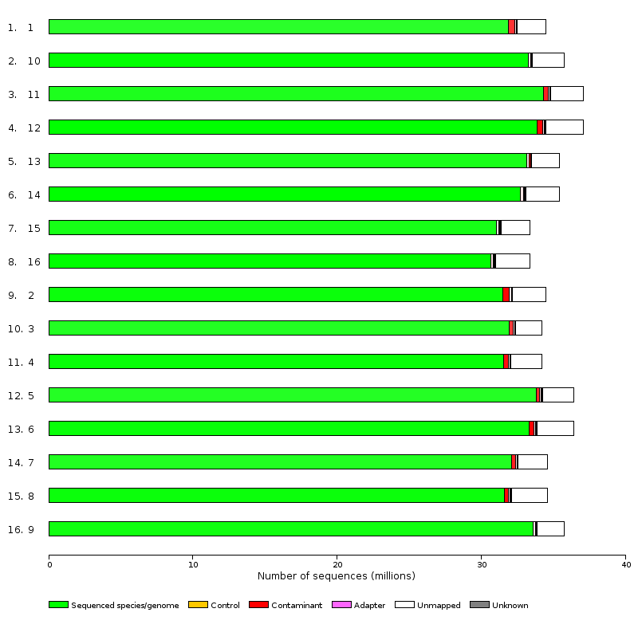
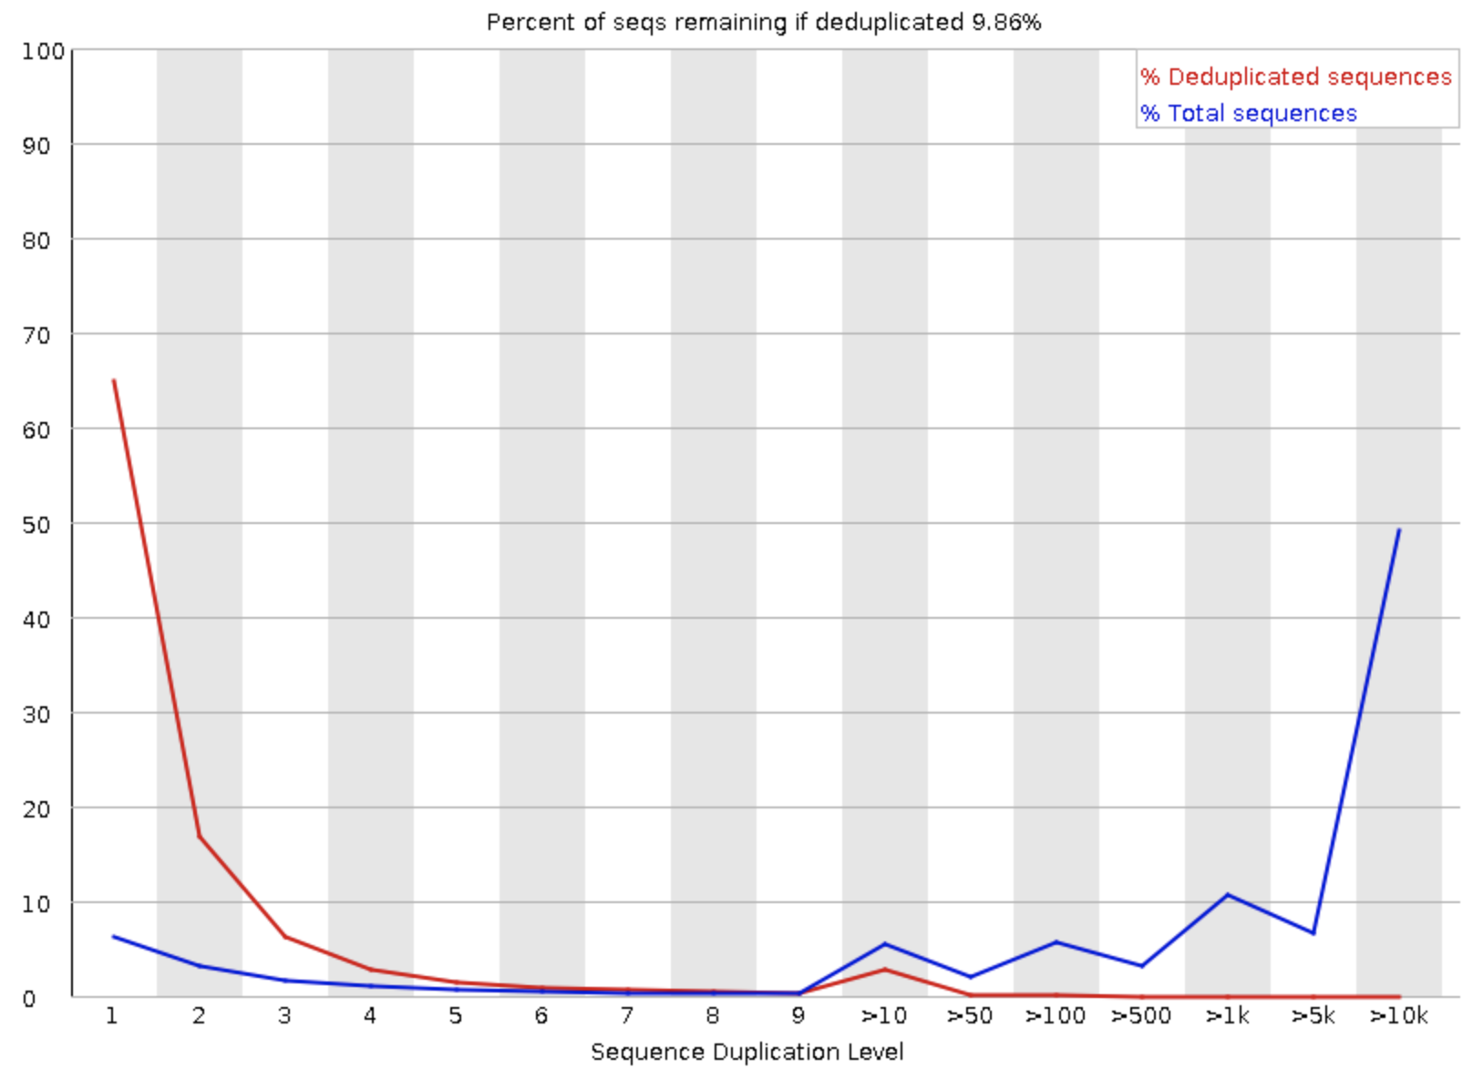
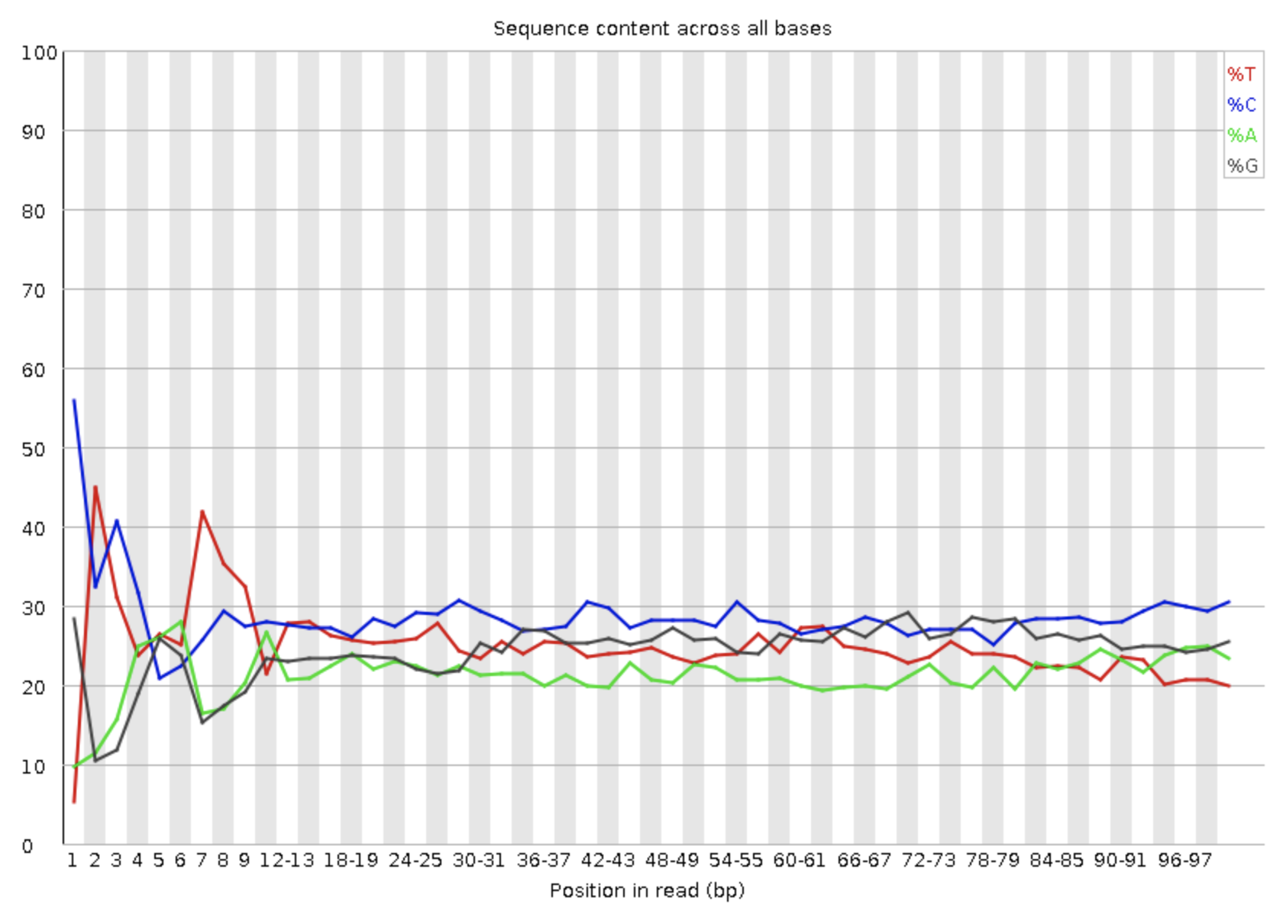
Quality Control
a) Multiple Genome Alignment
b) Quality Score Distribution
c) Sequence Duplication Rates
d) Sequence Content
Notes:
a) Reads can be mapped against multiple different species’ genomes to confirm that they map predominantly to the genome under study. This allows you to identify contaminants.
b) We can also check the base calling quality over the reads to check that there are no issues with poor base calling throughout. It is typical to see the quality drop towards the end of the read due to accumulation of fluorophores over the course of the cycle. Typically see worse quality for the reverse read.
c) Duplication rates can give us some indication of the presence of PCR bias or contaminant sequences (e.g. ribosomal RNA in RNA seq)
d) We can look for contaminants by observing the distribution of the sequence content over the read, since we should expect a roughly uniform split across all reads

Slide 19
Mapping
For experiments where a sequenced genome exists, the aim is to find the location in the genome/transcriptome from where each individual sequence originated
Mapping algorithms designed to quickly and efficiently find the most likely locus
Sequencing data are not exact:
DNA/RNA is fragmented prior to sequencing
Any enrichment steps may result in variable background
Fragmentation is not random
Fragments are amplified and PCR biases ensure this is not linear
Some regions of the genome are easier to sequence than others (e.g. euchromatin is less compact than heterochromatin)
Many repetitive regions of the genome – how do we resolve ambiguous mapping?
Ambiguous mapping more likely with shorter reads
Errors occur in sequencing
Mutations in the sample compared to the reference
Multiple alleles
Choice of mapping algorithm depends on type of data:
DNA – use Burrows-Wheeler transformation method like BWA or Bowtie2
RNA – need to account for large gaps in the alignment due to introns so use Tophat2 or STAR
Bisulfite – Must account for the depletion of cytosine in the reads
Notes:
Aim is to identify from which locus a particular DNA/RNA sequence originated
Pattern recognition problem, made more difficult by small size of fragments and large size of target genome
Multiple algorithms (Smith-Waterman, Burrows-Wheeler, heuristic pattern matching, etc.)
Other difficulties as outlined above
For DNA, we choose a method that maps to the target genome (separated by contigs, or chromosomes)
For RNA, we can map against the genome, but must account for the fact that introns are absent from the reads, so these will appear to be large gaps in the alignments
For bisulfite, we must account for the fact that the majority of all cytosines are converted to uracil (will appear as thymine in the cDNA output)

Slide 20
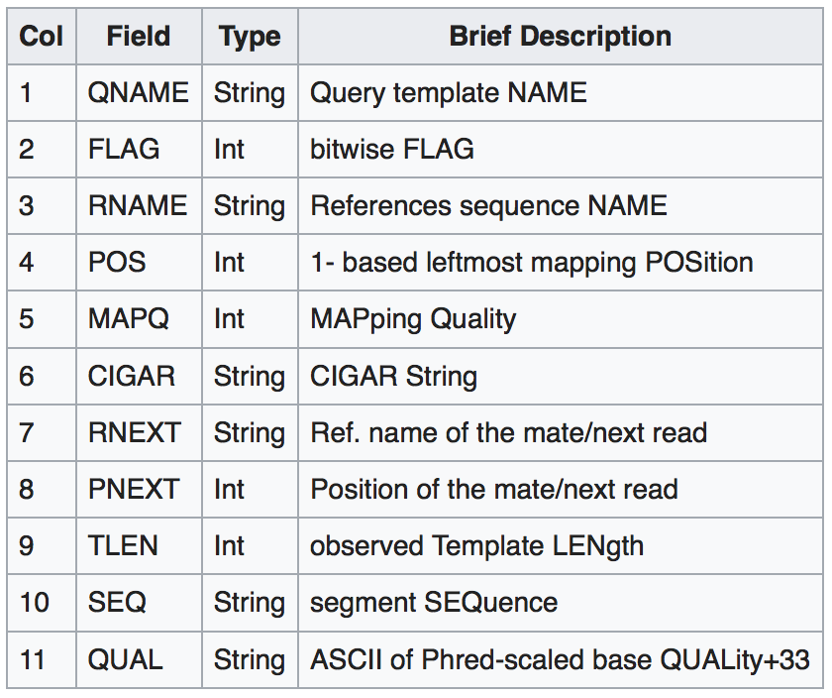
SAM/BAM format
Sequence Alignment Map (SAM) is the standard format for mapped data
Plain text format, or more efficient binary format (BAM)
Header lines (starting “@”) giving the length of the chromosome (RNAME)
>=1 line per read giving the read ID, a bitwise flag giving a lot of information about the mapping, mapping loci, mapping quality, difference from the reference (in CIGAR format), information on the mapping of the paired read (if any), the read sequence and quality, and a number of additional flags
@HD VN:1.3 SO:coordinate
@SQ SN:chr10 LN:130694993
@SQ SN:chr11 LN:122082543
@SQ SN:chr12 LN:120129022
@SQ SN:chr13 LN:120421639
HWI-ST300:393:C5YVGACXX:4:1214:10621:41421 163 chr10 3257078 50 60M = 3257079 61 CTCAGATACATAATAATACCCATCAACTCAGTGCCACTAAAGTTCACAAATTAATAGGGA BBB<FBFFFFFBFFFIFFFBFFF<FFBFFFFFBFFBBBFBBFBB77FFFFFBFBFFFFFB AS:i:0 XN:i:0 XM:i:0 XO:i:0 XG:i:0 NM:i:0 MD:Z:60 YT:Z:UU XS:A:- NH:i:1
HWI-ST300:393:C5YVGACXX:4:1312:14049:39916 163 chr10 3257078 50 60M = 3257079 61 CTCAGATACATAATAATACCCATCAACTCAGTGCCACTAAAGTTCACAAATTAATAGGGA BBBFFFFFFFFFFIIIIIIIIIIIIIIIIIIFFIIFIIFIBFFFIIIIIIFFIFIIIIII AS:i:0 XN:i:0 XM:i:0 XO:i:0 XG:i:0 NM:i:0 MD:Z:60 YT:Z:UU XS:A:- NH:i:1
HWI-ST300:393:C5YVGACXX:4:1214:10621:41421 83 chr10 3257079 50 60M = 3257078 -61 TCAGATACATAATAATACCCATCAACTCAGTGCCACTAAAGTTCACAAATTAATAGGGAG <FBB077<BB<F<F<B0<FFB07B'FBBBB77<<00<FFBFFB<F<B<FBB7B0FFFBB< AS:i:0 XN:i:0 XM:i:0 XO:i:0 XG:i:0 NM:i:0 MD:Z:60 YT:Z:UU XS:A:- NH:i:1
Notes:
SAM is a standardised format for holding mapped read information
Plain text, simple to read and understand, and highly portable
Binary format (BAM) can be indexed for fast access
Header gives information on the contigs/chromosomes in the target genome
Each read has at least one row in the data. Either 1 row but with no mapping information (if it does not map), 1 row with mapping information, or many rows if it maps to multiple loci
For paired end data, both forward and reverse rows are present
QNAME gives the name of the query template (read name)
FLAG column gives information on the mapping (and on the mapping of its pair if present)
RNAME gives the name of the reference sequence (contig or chromsome)
POS gives the position along the reference sequence (1-based, so the first base is number 1 not zero)
MAPQ gives the mapping quality score. However be aware that this is not always comparable between different algorithms. Bowtie 2 generates scores between 0-42, whilst BWA produces scores between 0-37. Some programs give a score of 255, but this usually means MAPQ was absent. Tophat gives scores of only 0 (maps to >5 loci), 1 (maps to 3-4 loci), 3 (maps to 2 loci), or 50 (uniquely mapped) even though it is based on Bowtie.
CIGAR gives the specific differences between the query and the target in a simple text format (see next slide)
RNEXT gives the reference sequence for the paired read
PNEXT gives the position of the paired read
TLEN gives the read length
SEQ gives the original sequence of the read
QUAL gives the original base calling quality scores of the read

Slide 21
SAM/BAM format - Flags
Simple flag gives a lot of information about the mapping
Given in the SAM file as a decimal, described in the table below as a hexidecimal, but makes sense as a binary number
Imagine as a series of binary switches that can be on or off
All numbers can be made up of the sum of distinct powers of 2
88 = 8 + 16 + 64 = 0x8 + 0x10 + 0x40 = 000001011000
So a read with flag 88 has an unmapped pair, is mapped to the reverse strand, and is the first of the paired reads
Notes:
The flag provides a simple way of encoding a lot of distinct information regarding the read
In particular whether it is paired [1], whether it is ”properly paired” i.e. both of the paired reads map [2], whether this read is unmapped [4], whether its pair is unmapped [8], whether it maps to the reverse complement (negative) strand [16], whether its pair maps to the negative strand [32], whether it is the first (forward) read in the pair [64], whether it is the second (reverse) read in the pair [128], whether this is a secondary alignment if the read maps to multiple loci [256], if the read fails quality control procedures [512]
Every combination of these binary numbers produces a unique decimal number
Therefore the flag (reported in decimal format in the SAM file) gives a lot of binary information about these different aspects of the read
Can be thought of as a series of switches when expressed as a binary number – The 0/1 on the far right represents bit 1, the next along towards the left represents bit 2, the next bit 4, etc.

Slide 22
SAM/BAM format - CIGAR
CIGAR string shows the difference between the read and the reference in a parsimonious way
Comprised of an operator (see table) preceded by the number of bases to which it applies
Examples:
50M means that the whole 50bp sequence matches (or mismatches…) the reference
25M3D25M means that there is a 3bp deletion in the middle of the 50bp sequence
15M4I31M means that the read contains a 4bp insertion compared to the reference after 15bp
Notes:
CIGAR format is a simple parsimonious way of representing the difference between the target sequence and the reference sequence
Accounts for contiguous runs of bases that show similar properties
Made up a number followed by an operator – this is the number of bases that differ/match the reference based on the given operator
M was originally defined as either a match or a mismatch. This became confusing so now we have two distinct operators – ‘=’ for a match and ‘X’ for a mismatch
Additional tag in the SAM file NM also gives the edit distance – the total number of differences between the target and the reference. E.g. NM:i:2 indicates there are 2 edits separating the target from the reference
More information here (https://genome.sph.umich.edu/wiki/SAM)

Slide 23
Contents
Introduction
Next Generation Sequencing
NGS Data Formats
ChIP-Seq
RNA-Seq
Whole Genome Sequencing
Bioinformatics Resources
Essential Bioinformatics Skills

Slide 24
ChIP seq - Introduction
Analysis of protein-DNA interactions
Typically used for transcription factor binding sites and histone modifications
DNA is crosslinked to the protein of interest and sheared
Specific antibody used to target protein or histone modification
Immunoprecipitation targets these antibodies, pulling down protein along with crosslinked DNA fragments
Crosslinking reversed, freeing up DNA fragments
Enriched DNA fragments sequenced and mapped to genome
https://en.wikipedia.org/wiki/ChIP-sequencing
Notes:
Chromatin Immunoprecipitation is a method of enriching a DNA population for those strands of DNA bound to a particular protein (e.g. transcription factors)
Since DNA are bound to histones, can also be used to pull down DNA bound to histones with particular modifications
Requires an antibody directed to the protein or modification of interest
The more specific and efficient the antibody, the less background DNA pulled down
DNA is crosslinked to the protein, sheared to look at DNA fragments (some of which are bound to the protein target), then the antibody is used for the pull down through immunoprecipitation
After reversing the crosslinking, the remaining DNA fragments are those bound by (or near to) the protein of interest
DNA is sequenced to produce clearly defined loci (peaks) of protein binding

Slide 25
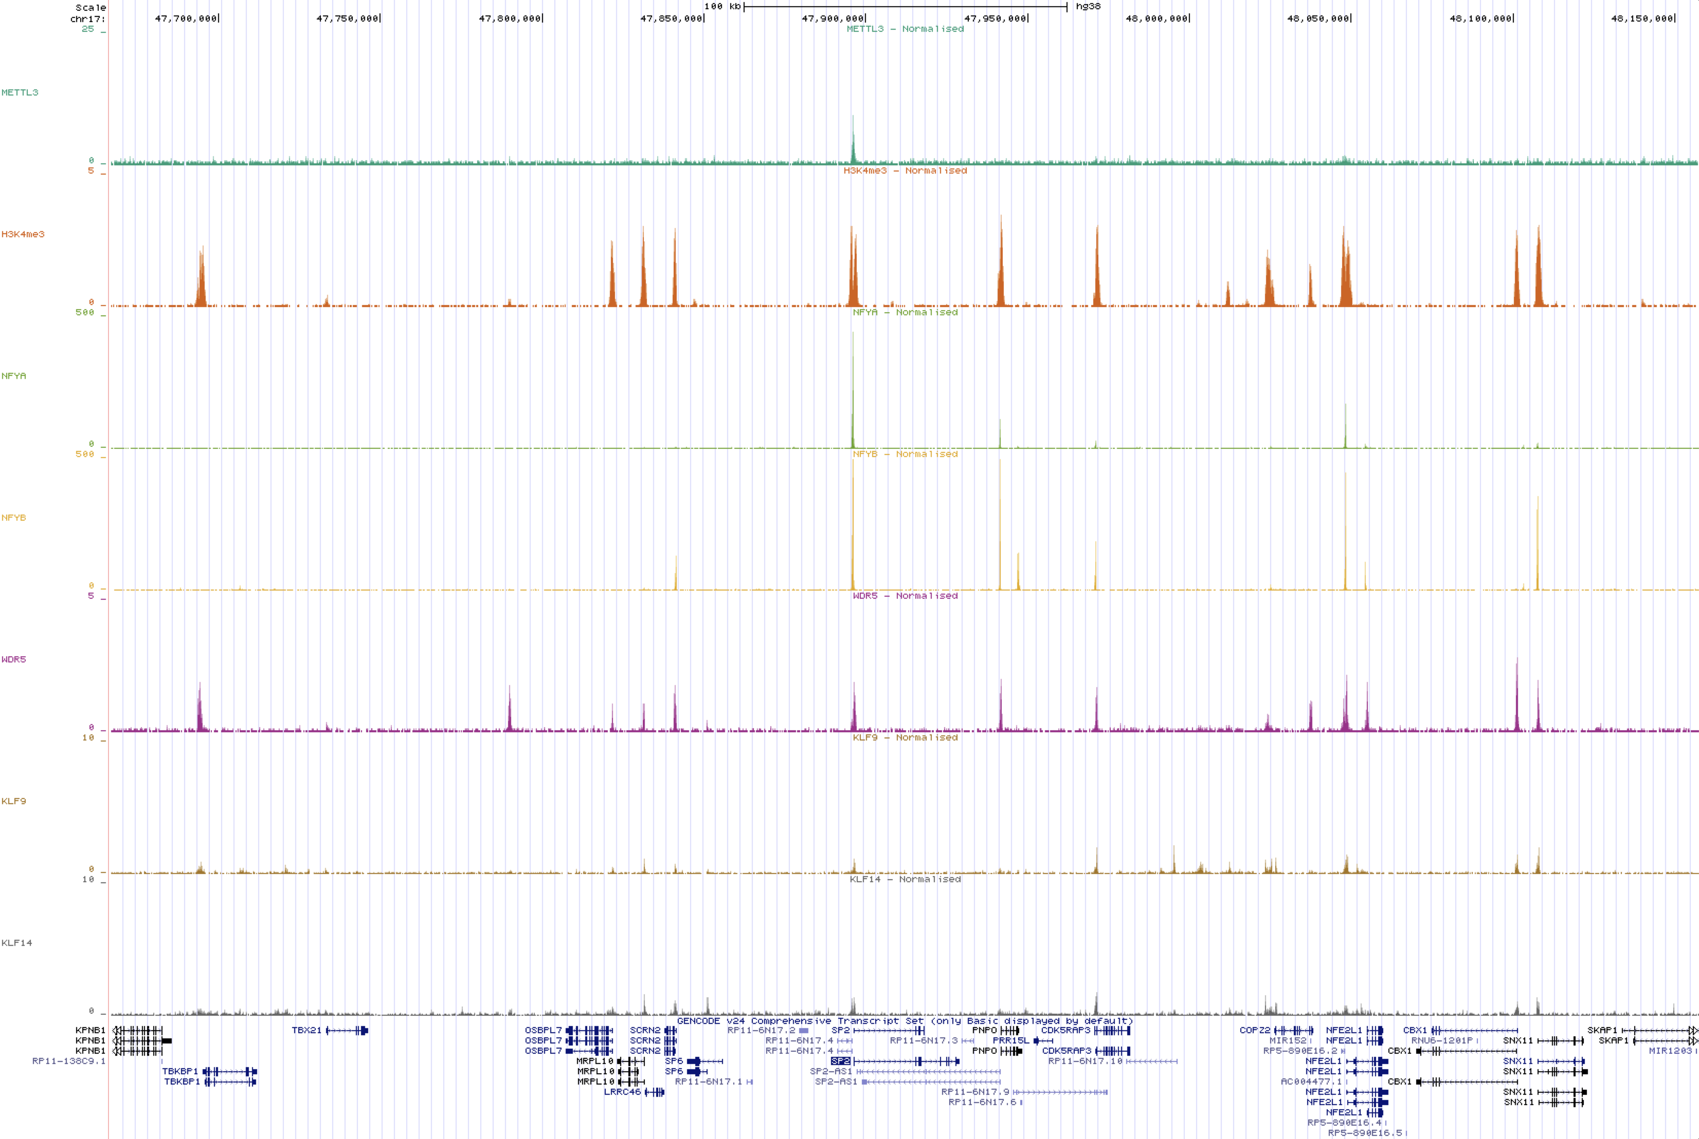
ChIP seq - Example
Notes:
Here you can clearly make out the characteristic peaks for transcription factor binding sites, showing their alignment with known genes and other factors
By aligning the tracks, we can identify regions of coregulation
Different levels of background signal are usually a result of differences in antibody efficiency

Slide 26
ChIP seq – Peak Calling
https://galaxyproject.org/tutorials/chip/
Notes:
In SE reads your reads account for the 5’ of the DNA fragment
But if your read is 50bp and your fragment size is 200bp you are missing 150 bp of the read
Half of your reads will be from the forward cDNA strand, half from the reverse cDNA strand
In PE reads you have sequence from the 5’ and 3’ end so have forward and reverse that match
You will end up with your reads making two overlapping distributions – forward reads on the left of the true peak, reverse on the right
We are interested in the position where the protein was binding which is in the middle of the fragments
Several methods for addressing this to identify the binding site
Method 1) Shift map coordinates in a 3’ direction by half the expected fragment length (or extend all of them to the fragment length) to find the binding site
Method 2) Pair the peaks up between the forward and reverse reads and find the central point between the opposite paired peaks
Method 3) Use an iterative probabilistic model until you converge on the binding site

Slide 27
ChIP seq – Downstream Analyses
Identify enriched sequence motifs amongst binding sites
Overlap with other related binding sites to identify coregulation
Differential binding between conditions
Identification of gene targets and gene ontology analysis
Binding site distribution relative to features (e.g. TSS, TES, enhancers, other transcription factors binding sites)
Overlap with annotated features (e.g. exons, introns, promoters, enhancers)
Notes:
We want to understand characteristics of the genomic loci where these factors are bound
For instance, are there short DNA sequence motifs that may be used as recognition sites by transcription factors
We may also be interested to find other factors that show similar binding patterns, which may indicate coregulation
We may see changes in the levels of binding of proteins or presence of chromatin marks between different conditions (e.g. different stages of development) so may be interested in testing for differential binding
We may be interested in which genes have a particular binding factor in the promoter, and then may look more closely at those genes to see if they have any shared functions through gene ontology analysis
We may be interested to look for evidence of association of our factor with known genomic features, so may wish to plot metaplots centered on these features. E.g. we can align the data for all genes and center our plot at the transcription start site (TSS) to see if the factor typically binds at this position
We can also look to see which features our factor overlaps with to gain an understanding of the function that it may have

Slide 28
Contents
Introduction
Next Generation Sequencing
NGS Data Formats
ChIP-Seq
RNA-Seq
Whole Genome Sequencing
Bioinformatics Resources
Essential Bioinformatics Skills

Slide 29
RNA Seq
https://en.wikipedia.org/wiki/RNA-Seq
https://images.nature.com/full/nature-assets/nbt/journal/v28/n5/images_article/nbt0510-421-F1.gif
Notes:
If we map RNA reads to a genome, we must account for the presence of introns in the reference genome that are not present in the processed mRNAs
Many methods for accounting for this – e.g. using known transcript maps to check mapping across known exon-intron boundaries
RNA reads that span exon-exon junctions will map against the genome but with large gaps
Aim to quantify reads amongst transcripts, and identify all exon-intron boundaries from the data to quantify specific isoform levels
Issue of many-to-many mappings – Reads may map to multiple loci, but a single loci may be shared be multiple isoforms of a single gene. How do you reduce ambiguities?
Stranded RNA seq assures that reads from overlapping genes on opposite strands do not get conflated
Novel isoform detection by looking at gapped alignments and sharing information across reads

Slide 30
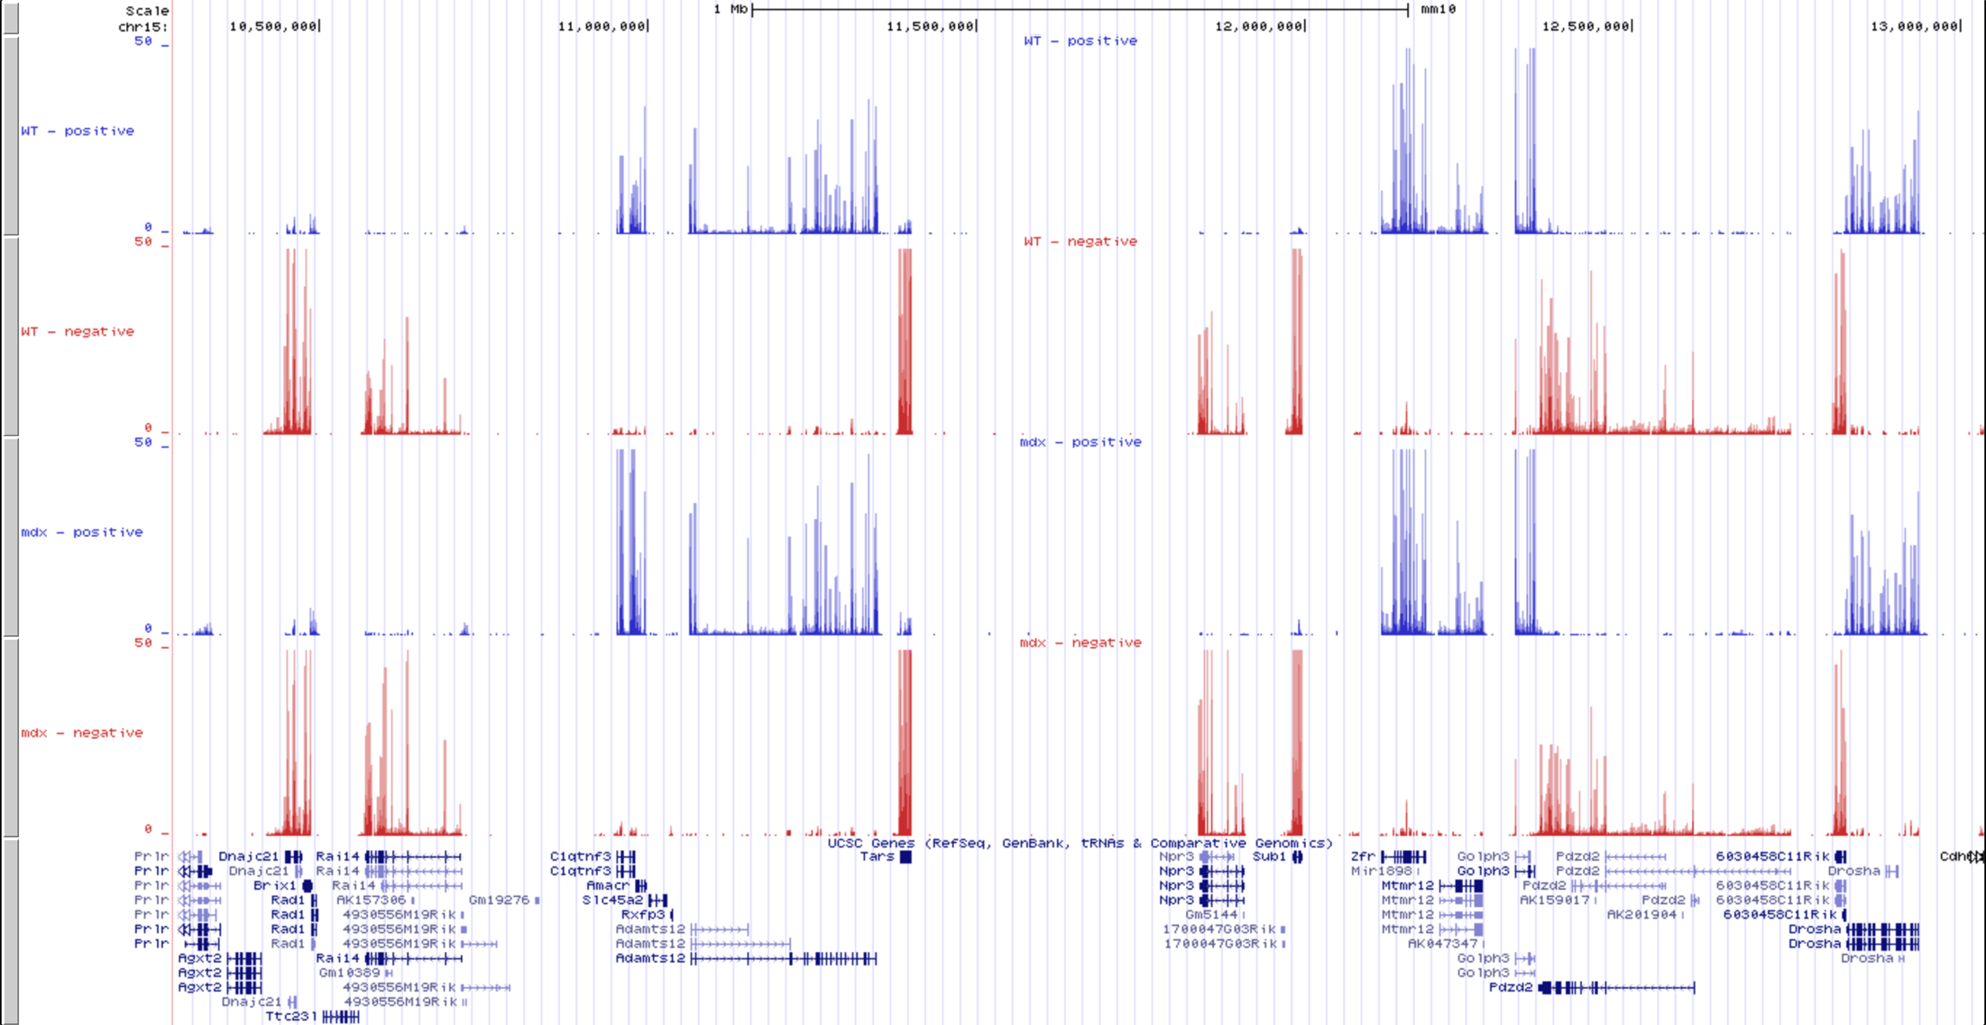
RNA Seq - Example
Notes:
Peaks in exons
Generally see little to no signal in introns (although we may see expression of non-processed pre-mRNAs present in our samples, or changes in splicing leading to intron retention)
Often see degradation from the 5’ to 3’ end, resulting in a decrease in signal
Mapping with a stranded protocol allows us to visualise data on forward and reverse strand and separate signal from overlapping (e.g. divergent) transcripts

Slide 31
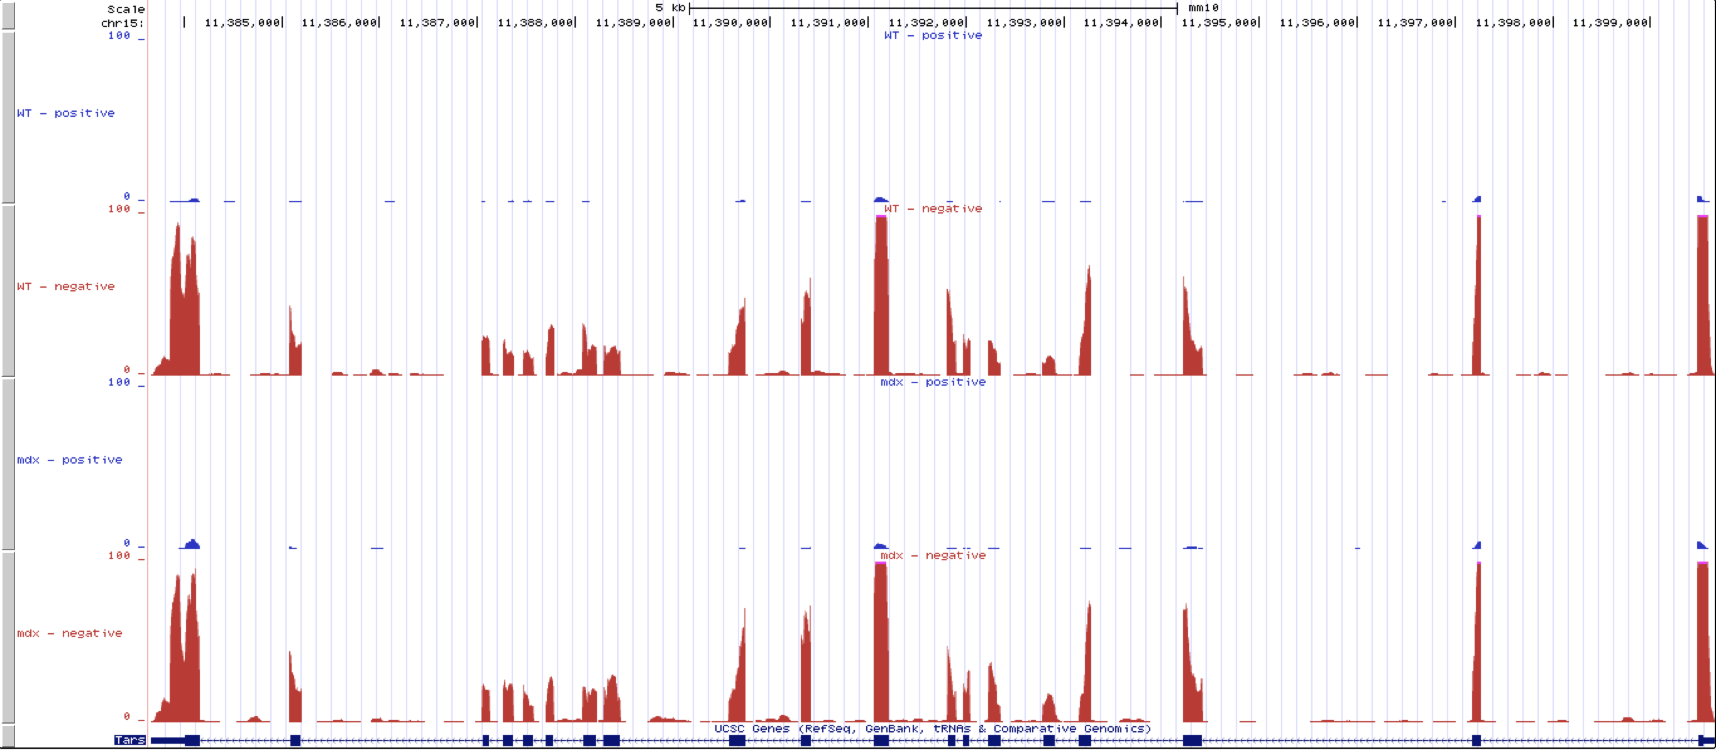
RNA Seq - Example
Notes:
Removing introns usually results in smooth distribution across transcript
The signal at the exon boundaries drops off suddenly in a very clear way
If the exonic signal in this case were copied and pasted together to remove the intronic signal, we would see a fairly smooth signal

Slide 32
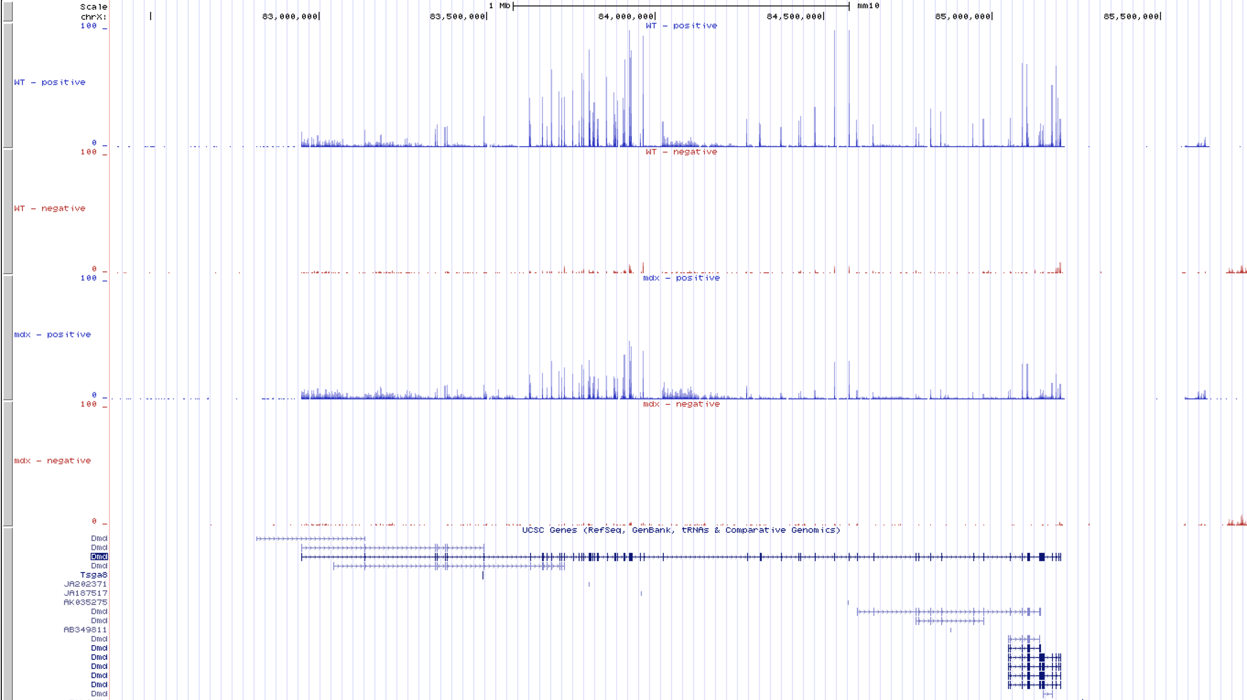
RNA Seq - Example
Notes:
Many genes have different isoforms with distinct functional roles
The dystrophin gene Dmd is the longest transcript in the genome and contains both long forms and shorter forms
Splice variants produce distinct proteins with different structures and functions

Slide 33
RNA seq – Downstream Analyses
Quantification of reads for individual genes/transcripts
Differential expression between conditions
Visualisation (Venn diagrams, volcano plots, heatmaps, etc.)
Gene Ontology analysis
Pathway analysis
Differential splicing analysis
Novel isoform detection
Notes:
The general aim is to quantify gene expression across the entire transcriptome, but more importantly we aim to compare and contrast this between different conditions
Differential expression analysis allows us to test for significantly changing transcript abundance across the entire dataset
Common tools (e.g. DESeq2 and edgeR packages in R) are based on using a negative binomial model to model the change in the counts across the transcripts, with a scaling factor to account for differences in the library sizes
Common to use a 2-fold change between conditions with a p-value less than 0.05 to determine “statistically significant” genes
However, this is dependent on the number of replicates – more replicates means more power to detect smaller changes at a given p-value threshold
P-value tells you the chance that you would see a change in expression at least as high as that which you have calculated - even if there were actually no biological difference between the groups
Be aware of multiple testing – the more times you perform a test like this, the higher the chances are that you will make false positive errors. When you are testing ~30,000 genes, you will get a lot of false positives. By correcting to give a false discovery rate, and filtering on this, we reduce our false positives.
Many ways to visualise these data – Venn diagrams to compare lists of genes between 2 or more conditions, volcano plots to show the pvalue against the fold change, heatmaps to identify clusters of genes acorss conditions, etc.
Gene ontology analysis uses manually curated lists of functional annotations for genes to determine if the groups that you see in your data are significant. Is it significant that 10% of my differentially expressed genes are cell cycle regulators? Probably not if ~10% of all genes are.
Pathway analysis is similar, and allows us to project our gene expression changes onto annotated pathways to understand how the gene expression changes affects the regulation in the pathway
Differential splicing analysis allows us to identify changes in the splicing patterns of isoforms, and and even to identify novel isofoorms in our data

Slide 34
RNA seq – Downstream Analyses
http://jem.rupress.org/content/jem/212/11/1771/F3.large.jpg
https://www.fiosgenomics.com/wp-content/uploads/2017/03/heatmap-1024x449.png
https://www.frontiersin.org/files/Articles/172388/fnins-10-00071-HTML-r1/image_m/fnins-10-00071-g002.jpg
Notes:
Can compare groups of target genes using Venn diagrams
Volcano plots show the p value against the fold change (on a log scale)
Network plots show interactions between genes and proteins, and can have fold change data overlaid to show enrichment
Heatmaps show expression levels for all samples and genes by using colour as a third dimension (e.g. red for upregulated, white for non-changing, and blue for down-regulated)

Slide 35
Contents
Introduction
Next Generation Sequencing
NGS Data Formats
ChIP-Seq
RNA-Seq
Whole Genome Sequencing
Bioinformatics Resources
Essential Bioinformatics Skills

Slide 36
Whole Genome Sequencing
Map against known genome and look for differences from the reference
SNPs, insertions, deletions, translocations, inversions
Requires high coverage to distinguish from base calling errors
Called variants can be compared against known databases (e.g. dbSNP)
Whole genome association studies identify variants associated with particular traits
Population genetics (e.g. 1000 Genomes Project) to identify variants associated with different populations
Notes:
When we map our reads against a target genome, we will find sites that differ from the reference
Sometimes these will be due to base calling errors, but often they can be representative of genetic variation between the target and the reference
Single Nucleotide Polymorphisms (SNPs) can be seen as single base changes
Also see deletions, insertions, translocations, inversions, etc.
Higher coverage provides evidence from distinct reads that the poymorphism is real
With high enough coverage we can distinguish homozygous and heterozygous variants
Variants can be compared with known databases to check for known associations with disease traits
Can also be compared with population panels such as 1000 Genomes Project

Slide 37
Whole Genome Sequencing
http://www.nature.com/ng/journal/v48/n9/fig_tab/ng.3592_SF7.html
Notes:
1000 Genomes Project panel performed deep sequencing for individuals from a number of individuals from various geographic populations
Populations chosen due to low levels of admixture - e.g. Yoruban tribe from Africa and Native Americans
Genotype calls are aggregated and principal component analysis (a method for reducing large data down to a small number of variables that account for the highest proportion of variation in the data) performed to identify differences between the populations
Clear differences between different populations can be identified

Slide 38
Contents
Introduction
Next Generation Sequencing
NGS Data Formats
ChIP-Seq
RNA-Seq
Whole Genome Sequencing
Bioinformatics Resources
Essential Bioinformatics Skills

Slide 39
UCSC Genome Browser
genome.ucsc.edu
Online resource for visualisation of genomic data
Hosted by the University of California, Santa Cruz
Stemmed from the Human Genome Project to distribute initial results
Open source web page based on MySQL database
Huge amount of integrated data and genome annotation (genes, functional elements, histone marks, common SNPS, ncRNAs)
High coverage genome data for 46 species (human, mouse, drosophila, sloth, yeast, etc.)
“Tracks” allow you to visualise multiple data sources in parallel and compare
Notes:
One of several resources for visualising genome data on a “genome browser”
Represents the genome in a linear fashion and allows you to stack up “tracks” containing various sorts of data
Distribution type data (e.g. .wig and .bedgraph files) show distribution of some factor across the genome (e.g. transcription factor binding data showing cummulative read counts from a ChIP seq experiment)
Region type data (e.g. .bed files) show regions of the genome (e.g. peaks called from a ChIP seq experiment)
Gene models can be represented in e.g. .gtf format showing UTRs, exons, introns, stop codons, etc.
The UCSC browser has data from a huge number of different sources which can be loaded up onto a browser session
Also allows you to load in tracks from your own data
Binary format data (e.g. .bigbed, .bigwig, .bam) can be used rather than loading the data in completely – the UCSC browser then accesses the URL where the binary (and indexed) data are stored, and pulls down only the data needed for the current browser window (rather than for the entire genome)
There are also several additional mirrors of this browser for when traffic levels are high – e.g. genome-euro.ucsc.edu for the European mirror
Also consider the integrated genome viewer from the Broad Institute (IGV - http://software.broadinstitute.org/software/igv/)
UCSC has the advantage of having instant access to many high depth genome sequences for many disperate species, and integrated tracks for data from a hiuge number of sources (ENCODE, ensembl, refseq, dbSNP, etc)

Slide 40
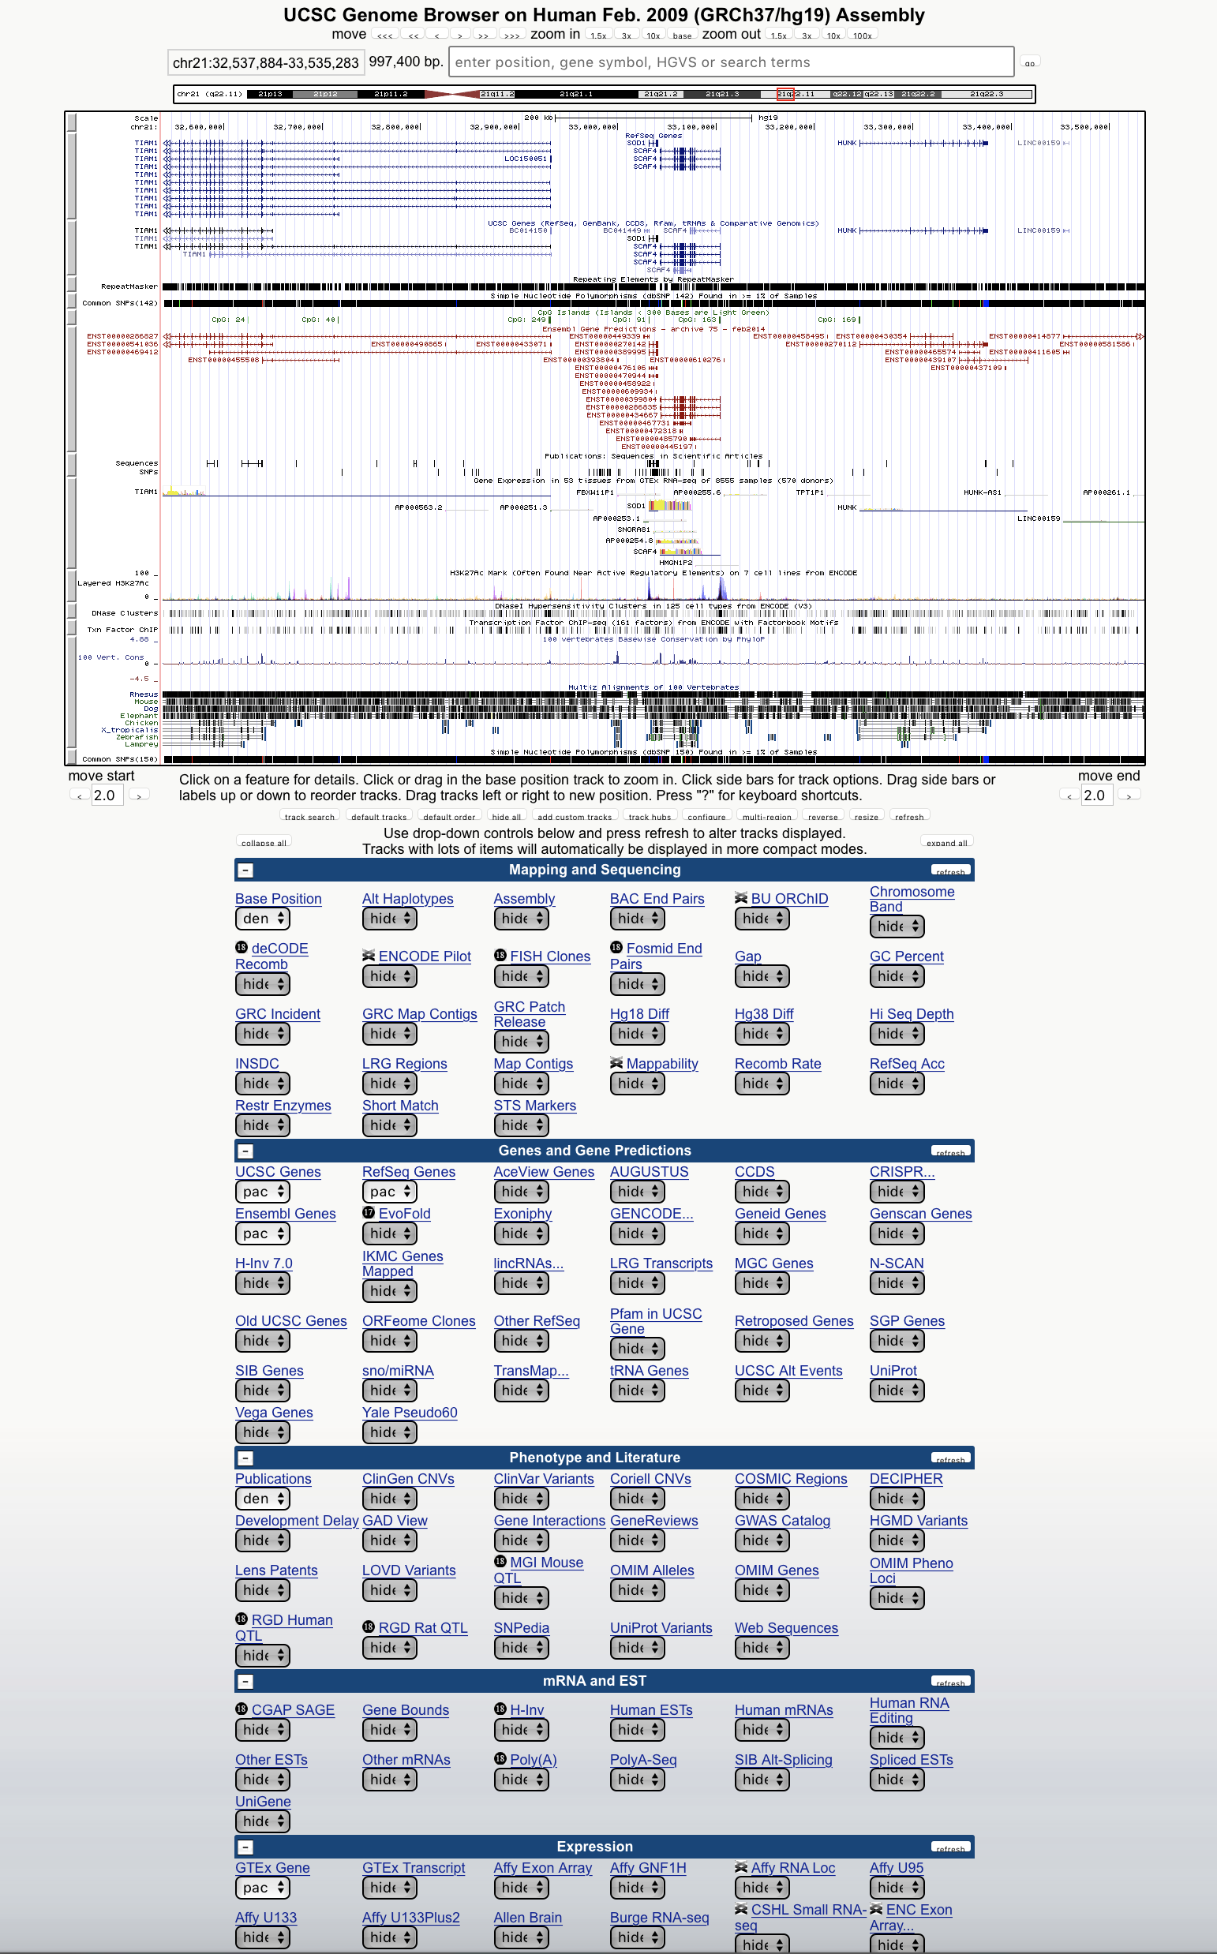
UCSC Genome Browser
Notes:
The browser window shows the region of the genome that you are interested in, and any tracks of interest can be selected from the list below
There is a huge amount of choice in how you display these data depending on how fine-grained you wish to look

Slide 41
ENCODE
https://www.encodeproject.org/static/img/classic-image.jpg
Notes:
The Encyclopedia of DNA Elements aims to categorise functional elements of the genome (human and mouse)
Combines data from many different techniques to categorise histone modifications (ChIPseq), long range DNA interactions (5C, ChIA-PET, Hi-C), DNA methylation (WGBS, RRBS, methyl array), gene expression (RNA seq), ncRNA interactions (CLIP-seq, RIP-seq)
Computer predictions have been used to combine these data to categorise different regions of the genome into groups dependent on their role - e.g. gene promoters, enhancers, repressors, insulators, super enhancers, etc.)
Data available for many different cell lines
A fantastic resource if you are interested in chromatin modifications and transcription factor binding

Slide 42
ENCODE
Notes:
These data can be loaded in directly through the UCSC browser
Note that ENCODE data were generated for the GRCh37/hg19 genome build, not the more recent GRCh38/hg38 build
It is possible to convert mapping coordinates between builds using the liftOver tool
Often possible to find histone modification data for a cell line comparable to the one that you are using, allowing direct comparison with your own data

Slide 43
NCBI
National Center for Biotechnology Information
NIH funded resource containing several important resources:
Pubmed (publications)
Genbank (DNA sequence database)
RefSeq (nucleotide sequences (DNA, RNA) and protein products)
BLAST (basic local alignment search tool)
SRA (Sequence Read Archive)
Notes:
NCBI is funded by the National Institute of Health and contains many very useful databases
Pubmed is the go to source for accessing publications in the scientific world
Genbank contains all known publicly available curated DNA sequences (and their protein products)
Refseq contains annotated and unique records for all DNA, RNA and protein products in well categorised model organisms (unlike Genbank which can contain any DNA sequence regardless of the species)
BLAST is a tool for alignment of short nucleotide or amino acid sequences against some database (e.g. Genbank and Refseq). It uses a heuristic method to identify sequences contain short “seed” matches, then uses a local alignment tool to identify the optimum match.
SRA is a database for the storage of curated sequencing data. Submitting sequencing data (usually raw fastq data and processed BAM files, along with downstream files such as called peaks or read counts for RNA seq) is usually a prerequisite for publication.

Slide 44
Contents
Introduction
Next Generation Sequencing
NGS Data Formats
ChIP-Seq
RNA-Seq
Whole Genome Sequencing
Bioinformatics Resources
Essential Bioinformatics Skills

Slide 45
Essential Bioinformatics Skills
Computer programming expertise
Experience working in a Linux environment
Data manipulation (perl, awk, python, sed)
Statistics (R, SPSS)
Database management (mysql)
Regular expressions and pattern matching
Interdisciplinary communication

Slide 46
So You Want to Become a Bioinformatician?
Take some programming training courses (try online – Lynda Learning, Coursera, Code Academy)
Bioinformatics training courses (many excellent courses in Cambridge at EBI and Sanger Institute)
Visit bioinformatics resources to see example data
Play with some example data
Practice, practice, practice!
github.com/uopbioinformatics/uopbioinformatics.github.io
samuel.robson@port.ac.uk

Slide 47
Questions?

