Slide 1
Bioinformatics at the University of Portsmouth
Sam Robson, IBBS Research Day
Notes:
Thank you for the introduction and giving me an opportunity to introduce myself to the faculty
Very pleased to be back in Portsmouth
This is somewhat of a homecoming for me
I grew up in Portsmouth and went to school at St John’s College down the road
It’s like the last 20 years never happened
I’m looking forward to the opportunity to collaborate with many of you on the various projects being undertaken at the university

Slide 2
What Do Bioinformaticians Actually Do?
http://blog.fejes.ca
Notes:
Of course, you might rightly ask “why would I need your help”?
What does a bioinformatician actually do?
As a bioinformatician my job to make sense of the vast array of data produced in biological experiments
Data are becoming more and more unwieldy
Particularly with the prevalence of high throughput sequencing
More and more biological projects will need bioinformatics assistance at one stage or another

Slide 3
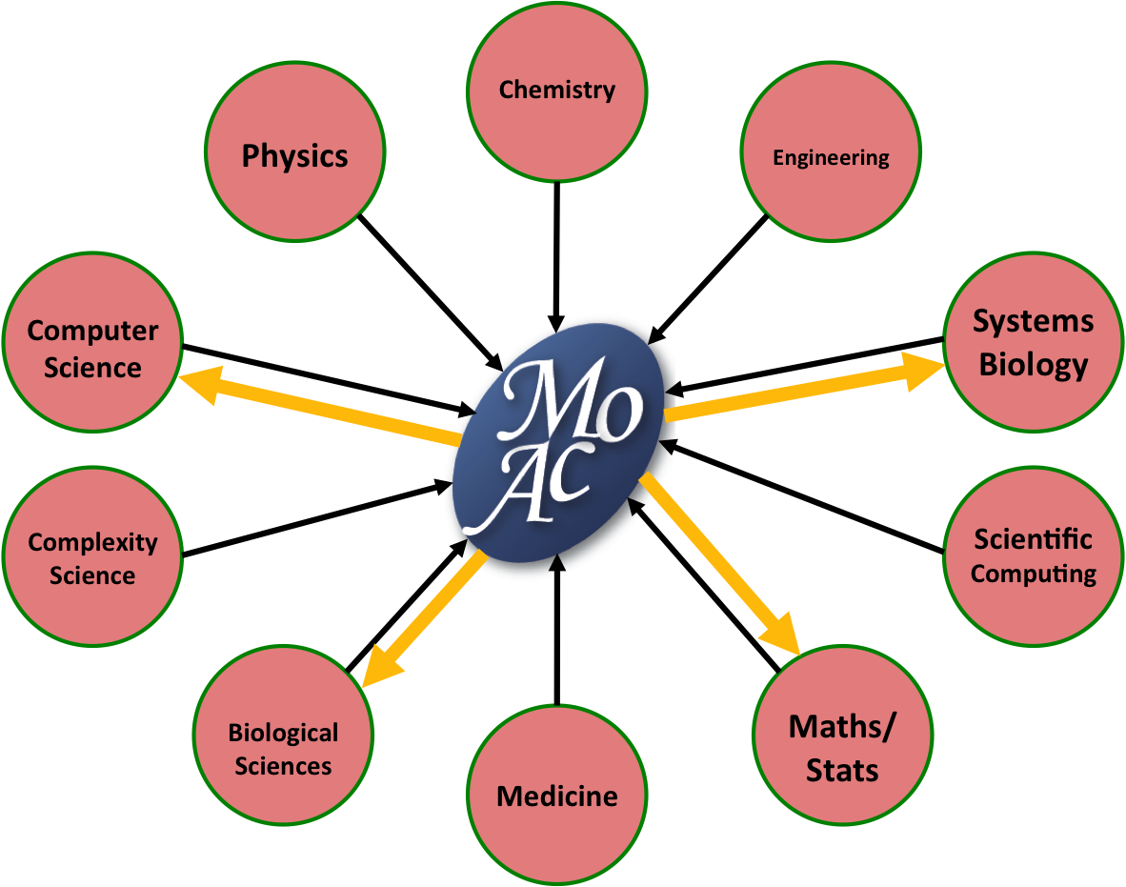
Background
Training:
BSc – Mathematics
MSc – MOAC Doctoral Training Center
PhD – Mathematical Biology and Biophysical Chemistry
Experience:
Statistical/Mathematical Biologist at Wellcome Trust Sanger Institute
Bioinformatician at Wellcome Trust/CRUK Gurdon Institute
Notes:
Background as a mathematician
Trained in a multi-disciplinary masters program
The aim was to train scientists from a variety of backgrounds in all aspects of the life sciences to allow effective communication at the interface between the life sciences
PhD was a cross between wet lab biology and bioinformatics
Working at the bench has given me a unique perspective on how data are generated
Since then I have concentrated on computational aspects of analysis
Worked at the Sanger Institute under Matt Hurles
Identification of genomic variants associated with common diseases
Worked at the Gurdon Institute with Tony Kouzarides
Categorisation of histone and (more recently) RNA modifications, and their links to cancer

Slide 4
Expertise
General statistics
RNA seq
differential expression analysis
gene ontology analysis
pathway analysis
ChIP seq
peak calling
annotation against known features
comparison between data sets
Various other sequencing technologies (biosulfite seq, CLIP seq, ChIRP seq, ribosome profiling, amplicon seq, etc)
Programming (particularly R and perl)
Database interrogation (MySQL)
Pipeline development
Notes:
I have expertise in all aspects of statistical data analysis
I can help with any area of statistical analysis, from ANOVA to Z-tests
Fellow of the RSS, currently awaiting Chartered Statistician and Chartered Scientist status to be granted
In particular, my recent expertise have been focused on the analysis of high throughput sequenincg data
I have worked extensively with RNA seq and ChIP seq
Also with many other sequencing data sets
Fluent in many programming languages, particularly R and perl

Slide 5
Sequencing Centre
Read Data (.fastq)
Process reads
Quality Control
Trim adapters
Read cleanup
fastQC
MGA
Mapping
BWA
Bowtie2
Tophat2
STAR
Database
Web Server
Sort, process and filter
samtools
bedTools
Create output files
Mapped Read Distribution (.bedgraph)
Mapped reads (.bam)
Mapped Read Distribution (.bigwig)
Expression Analysis
UCSC Browser
Peak calling
Transcript coverage
MACS
Findpeaks
cufflinks
DEseq2
Called Peaks
(.bed)
Differentially expressed genes
Notes:
Developed and maintained pipeline for processing of sequencing data
Processed about 50 billion reads in my last position
Simple way to disseminate data to collaborators

Slide 6
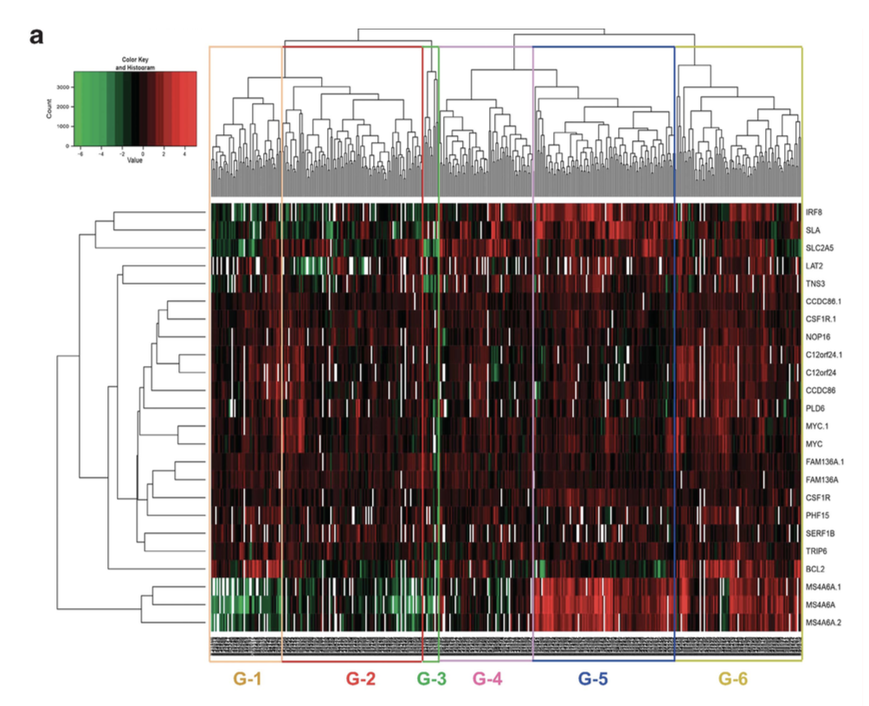
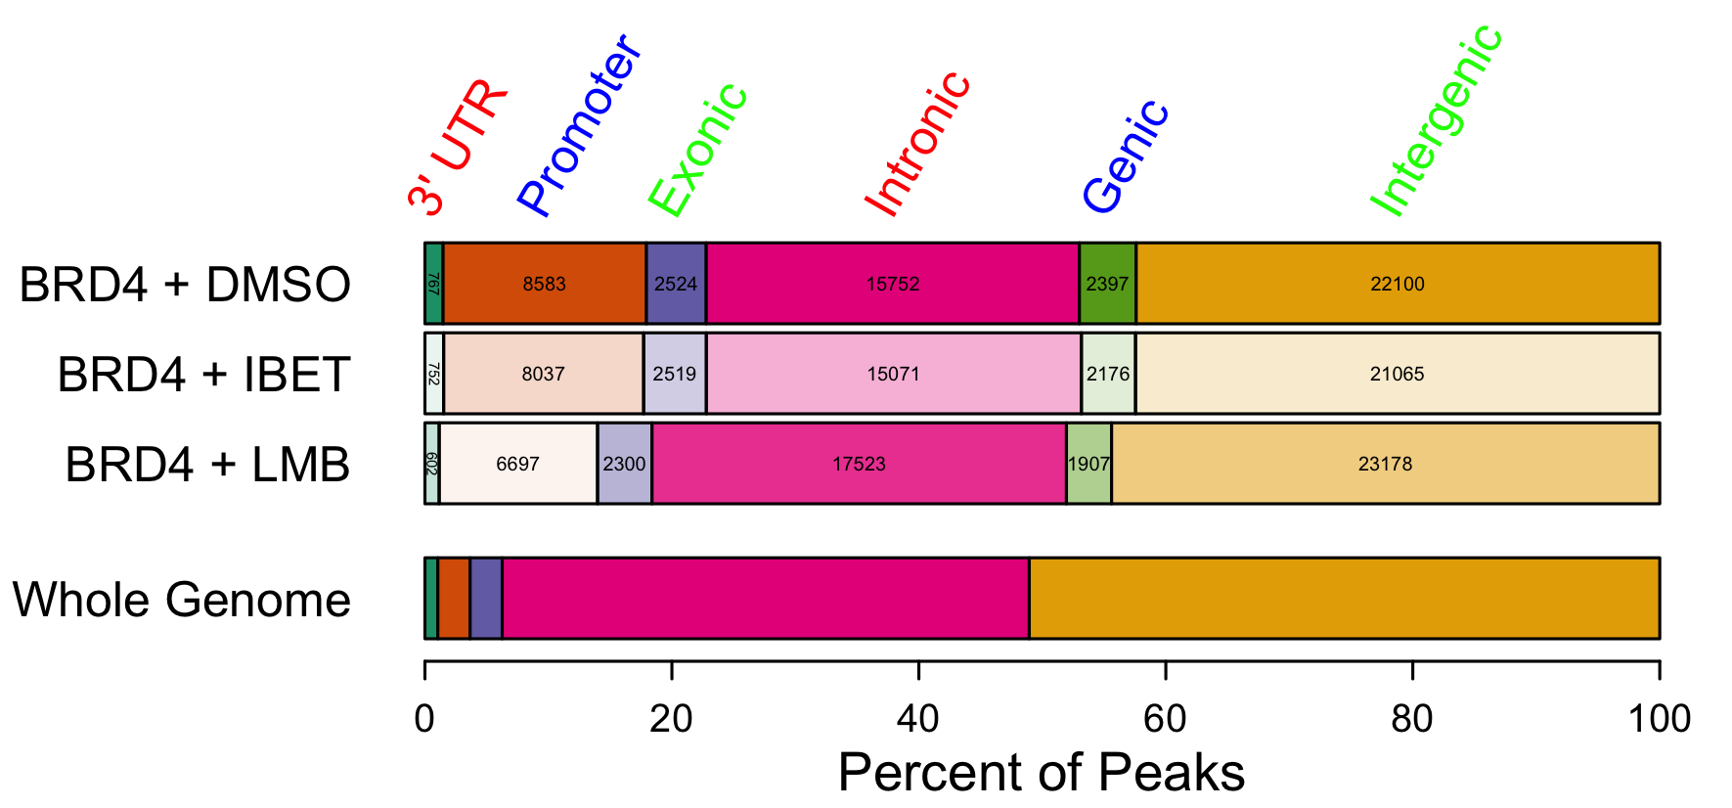
Previous Work
Study looking at effect of BET inhibitor “IBET151” on AML
BET proteins regulate a HOXA-independent ‘core’ transcriptional program in AML
Common across broad range of AML subtypes
These genes are enriched for superenhancers
IBET151 reduces BRD4 binding at downregulated genes
Supports the use of BET inhibitors in clinical trials in AML
Notes:
OCI-AML3 – AML cell line containing mutation in NPM1c (nucleophosmin)
SKM1 – AML cell line containing mutation in EZH2
I-BET treatment results in low changes in gene expression
Common overlap between these and MML cell lines
26 genes commonly downregulated
Doesn’t include HOX genes, so HOX independent
NPM1c mutation is commonly associated with aberrant expression of HOXA

Slide 7
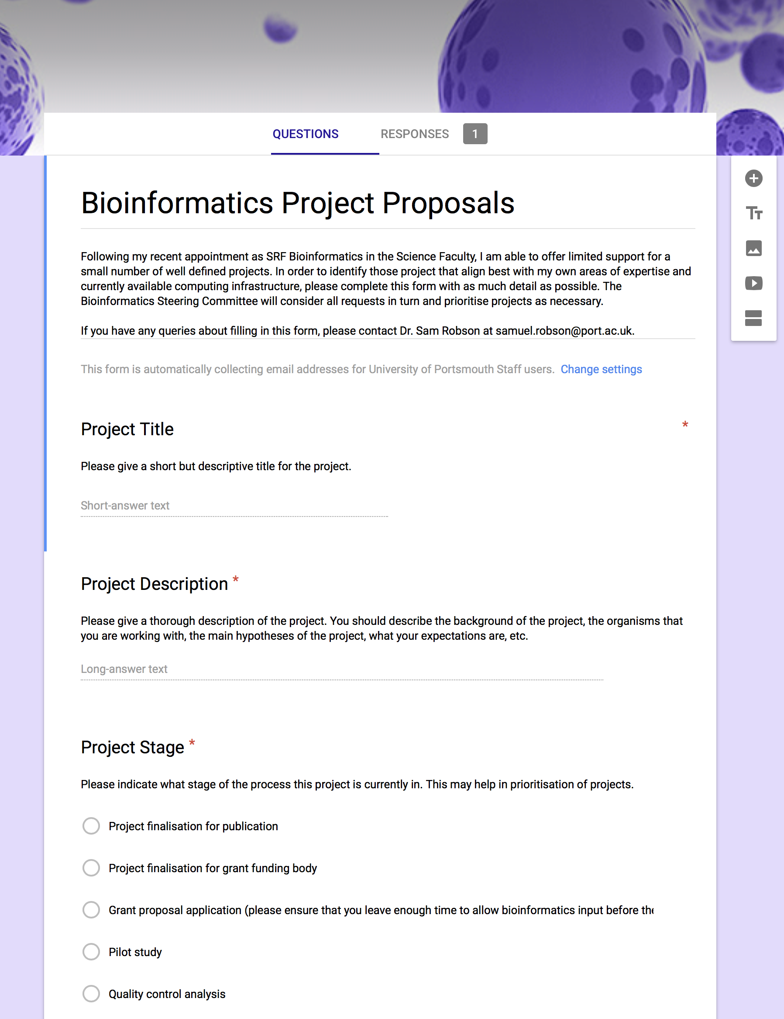
Collaborations
Steering Committee to help prioritise projects
Pro forma to define:
Project aims
Level of bioinformatics support required
Types of data expected
Stage of the project
Experimental design
I can (and should) work with you to design the experiment
Notes:
IMPORTANT – I am not a core service
I am a researcher looking to collaborate on research projects that have a bioinformatics element
As well as developing my own research portfolio
There are likely many projects throughout the faculty in need of bioinformatics assistance
This could be:
- guidance on experimental design
- standard analyses, like pulling out differentially expressed genes from an RNA seq data set
- more in depth data mining endeavours
We have set up a steering committee to allow me to priorotise potential collaborations
There is a pro forma available where you can outline the project and the bioinformatics support that you would require
This will be sent out to the faculty

Slide 8
Bioinformatics Training
Bioinformatics:
Introduction to bioinformatics
How to use common bioinformatics tools (e.g. BLAST, HMMer, ClustalW, biomart, MEME, DAVID, Homer)
How to access common bioinformatics resources (e.g. Ensembl, UCSC browser, GEO, ArrayExpress, Interpro, Pfam, KEGG)
Next Generation Sequencing:
Designing an NGS experiment
Analysing ChIP-seq data
Analysing RNA-seq data
Programming and statistics:
Data processing using perl
Data analysis using R
Notes:
I will be running various training seminars
On various aspects of bioinformatics
The idea is to help train MRes and PhD students
But also to give researchers the tools that they need to perform some bioinformatics analyses independently
Also important to understand the “black box stuff” that the bioinformaticians are doing to your data

Slide 9
Future Plans
Further develop the Bioinformatics Group
Bioinformatics training seminars
Regular “Data Clinic”
Opportunities for joint grant proposals
Opportunities for joint MRes/PhD project proposals
Development of bioinformatics tools for the community
Notes:
Ultimately I want to build a group here and make Portsmouth a center of excellence for bioinformatics
During my time here, I want to help the faculty to understand more about what bioinformatics is and what you can do with these tools
As well as the training seminars, I want to hold a regular data clinic, which will be a session every couple of weeks where researchers can book a short slot to discuss some simple data questions
For example how to design an experiment, number of replicates, pooling strategies, choice of barcodes, sequencing technologies
In addition I hope to work closely with many of you to secure funding for projects with a high level of bioinformatics in the future
I would also be interested in looking at some potential project proposals for masters or PhD students that could have a heavy dose of bioinformatics
Perhaps we could discuss these at a later date

Slide 10
Realistic Future Plans…

